Slide 1
Calorie Tracker
Submitted by – Riya [2420593]
Course – Python Programming
College- Chandigarh Engineering college

Slide 2
What is calorie tracker?
Calorie Tracker is a Python-based desktop application that helps users monitor their daily health activities by tracking:
Daily Calories
Water Intake
Exercise
BMI
Reports
Progress Graphs

Slide 3
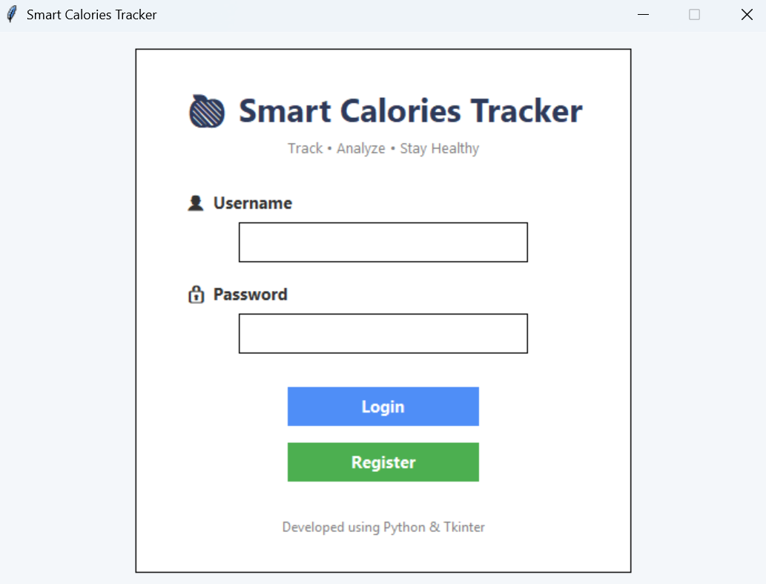
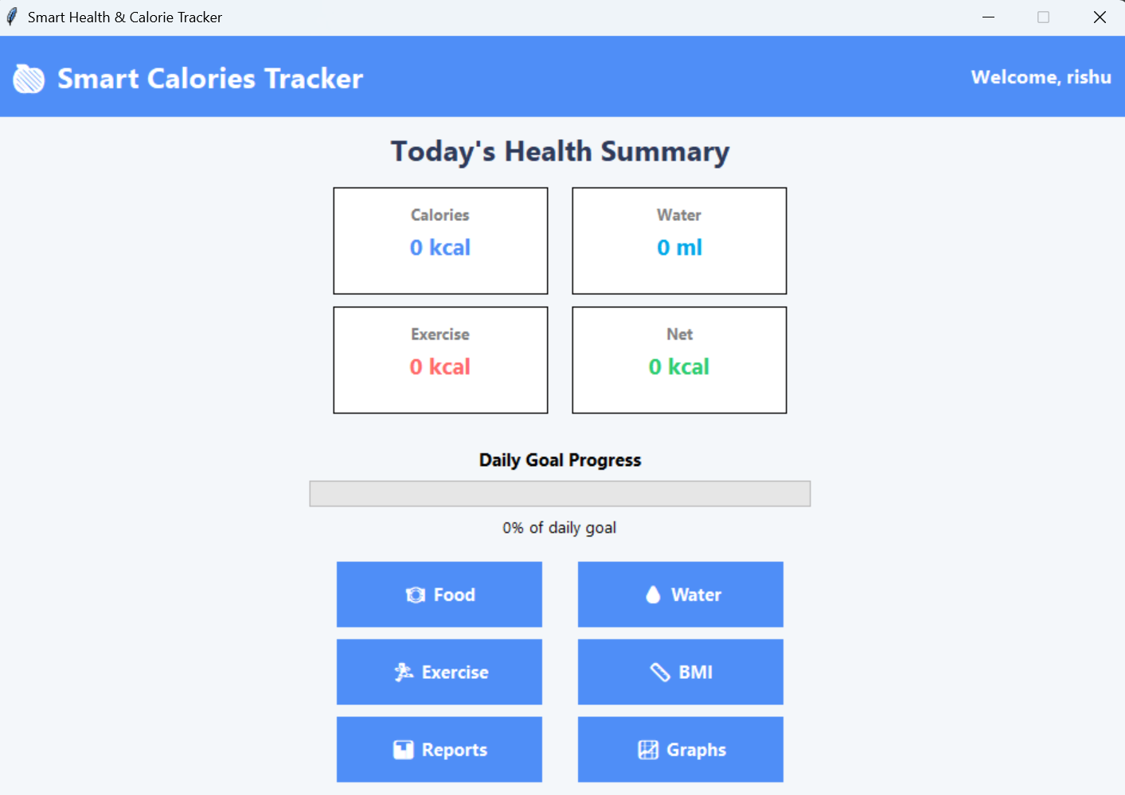

Slide 4
Problem statement
Maintaining a healthy lifestyle requires continuous monitoring of various health parameters. Most people either forget to maintain records or use multiple applications for different purposes.
Existing Problems:
Manual calorie calculation is difficult.
No centralized health management.
Daily records are often lost.
BMI calculation requires separate tools.
Progress analysis is not available.

Slide 5
Objectives
The main objective of this project is to develop an easy-to-use desktop application for monitoring daily health activities.
Objectives
Develop a secure login system.
Track daily food consumption.
Monitor water intake.
Record exercise activities.
Calculate Body Mass Index (BMI).
Store health records using CSV files.
Display reports and graphical analysis.
Apply Object-Oriented Programming concepts.

Slide 6
Technologies used
Python - | Programming Language
Tkinter - | GUI Development
Pandas - | Data Handling
CSV - | Database Storage
Matplotlib - | Graphs
OOP - | Code Structure
Datetime - | Date Management

Slide 7
Concept Used:
This project demonstrates most of the concepts covered during the Python course.
Variables and Data Types
Conditional Statements
Loops
Functions
Lists
Dictionaries
File Handling
Exception Handling
Modules
Object-Oriented Programming
Pandas Data Frame
Matplotlib Graphs

Slide 8
Tracking Modules
Food Tracker -Stores calories and nutrients consumed.
Water Tracker -Records daily water intake.
Exercise Tracker -Tracks calories burned through physical activities
BMI Calculator -Calculates Body Mass Index using height and weight.

Slide 9
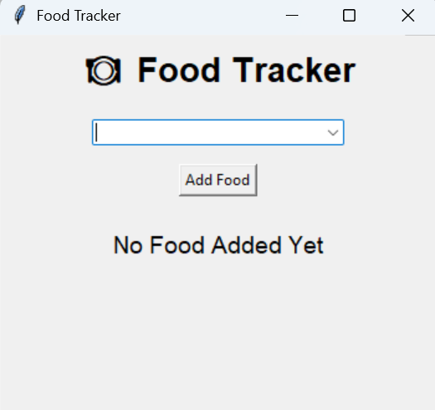
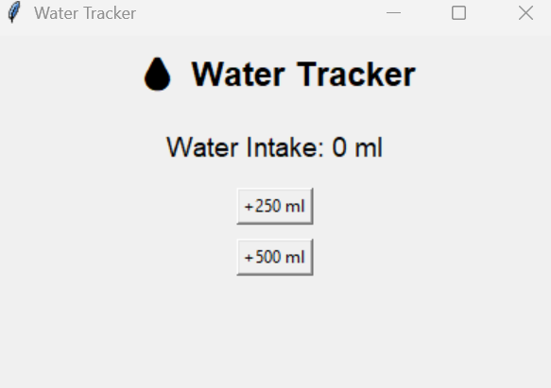
Tracking modules

Slide 10
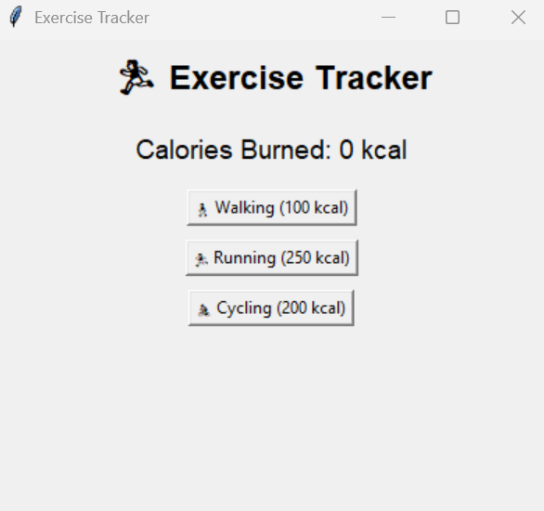
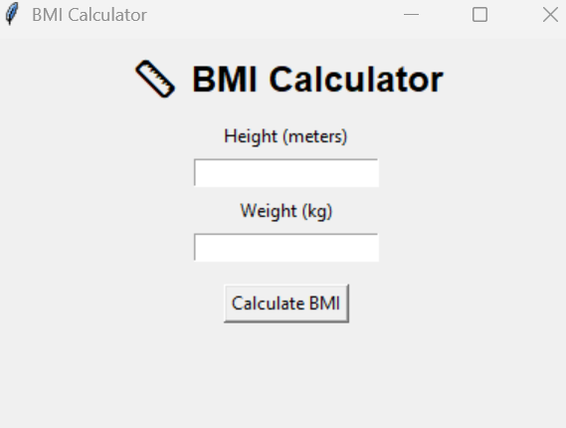
Tracking Modules

Slide 11
Reports And Graphs
Reports-
Daily Records
Nutrition Data
Water
Exercise
Graphs-
Calories Trend
Water Trend
Exercise Trend

Slide 12
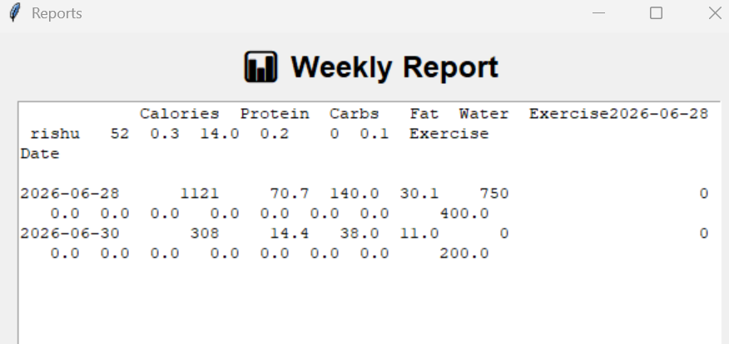
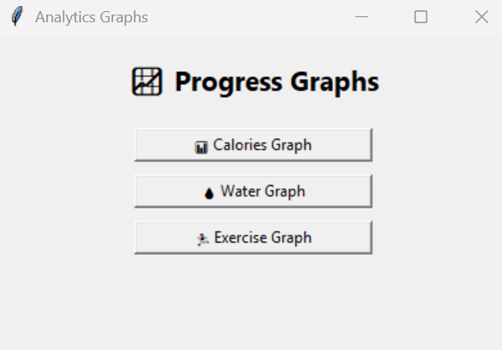

Slide 13
Data Management
users.csv
Stores:
Username
Password
history.csv
Stores:
Date ,Calories ,Protein
Carbs ,Fat
Water ,Exercise

Slide 14
Future Enhancements
AI Food Recommendation
Barcode Scanner
Nutrition API Integration
Email Reports
User Profile Images
Mobile Application
Cloud Backup
Camera

Slide 15
Thank you………

